Slide 1
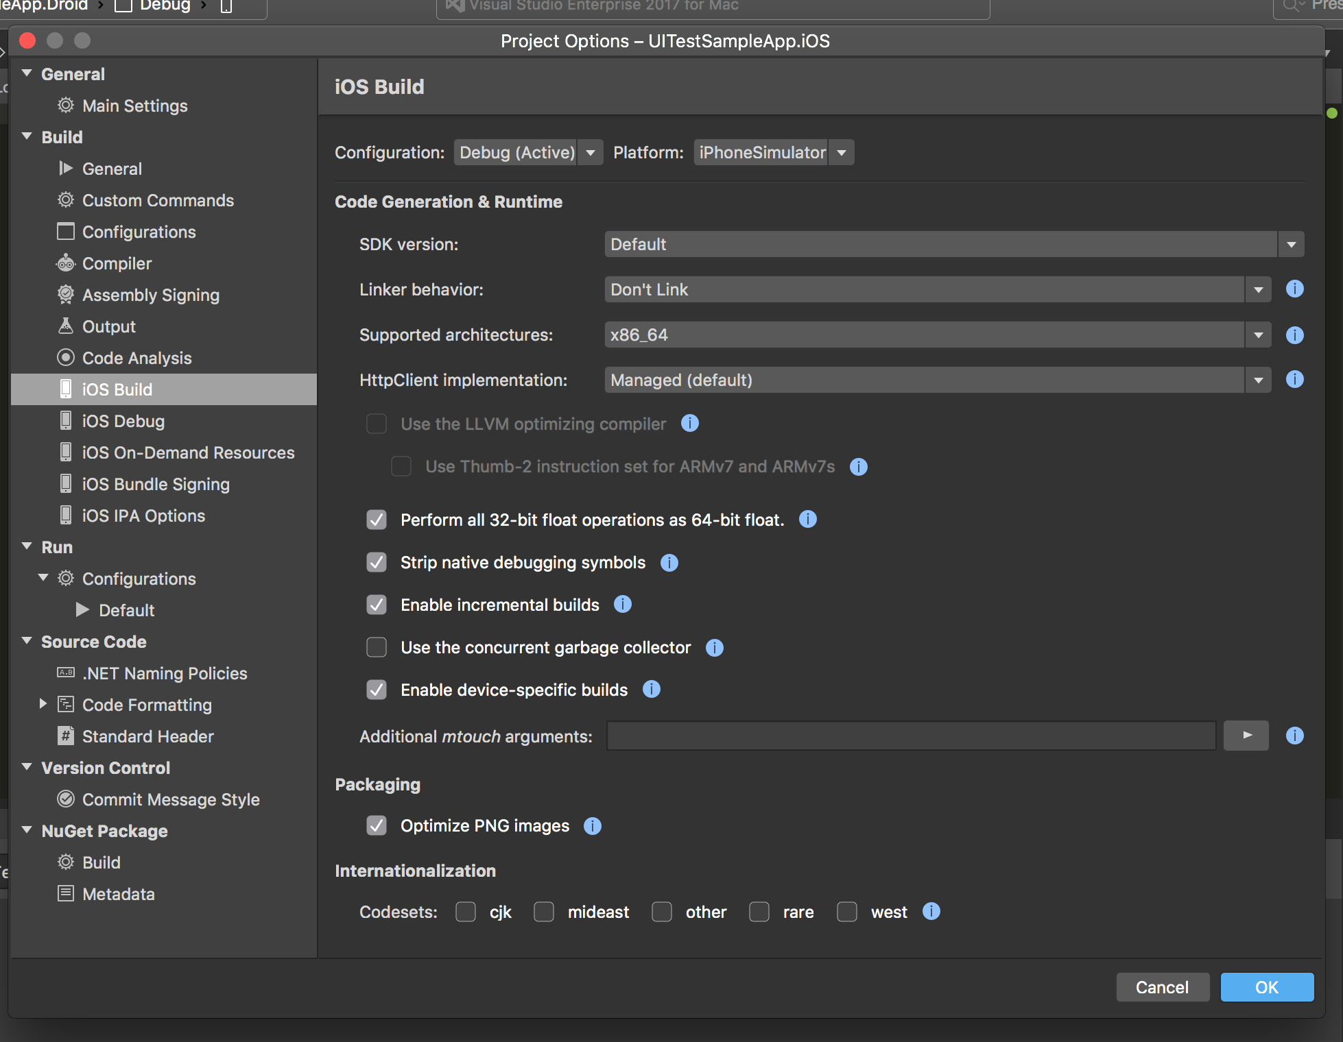
iOS Build Settings
Linker behavior: Don’t Link
Linking will cause compilation to take longer
Supported architecture: x86_64
Selecting multiple architectures will cause compilation to take longer
X86_64 works for iPhone Simulators 5s - 7
i386 works for iPhones earlier than the iPhone 5s
Enable incremental builds
This will allow the compiler to only compile code that has changed
Enable device-specific builds
This encourages the compiler to only compile for the targeted device

Slide 2
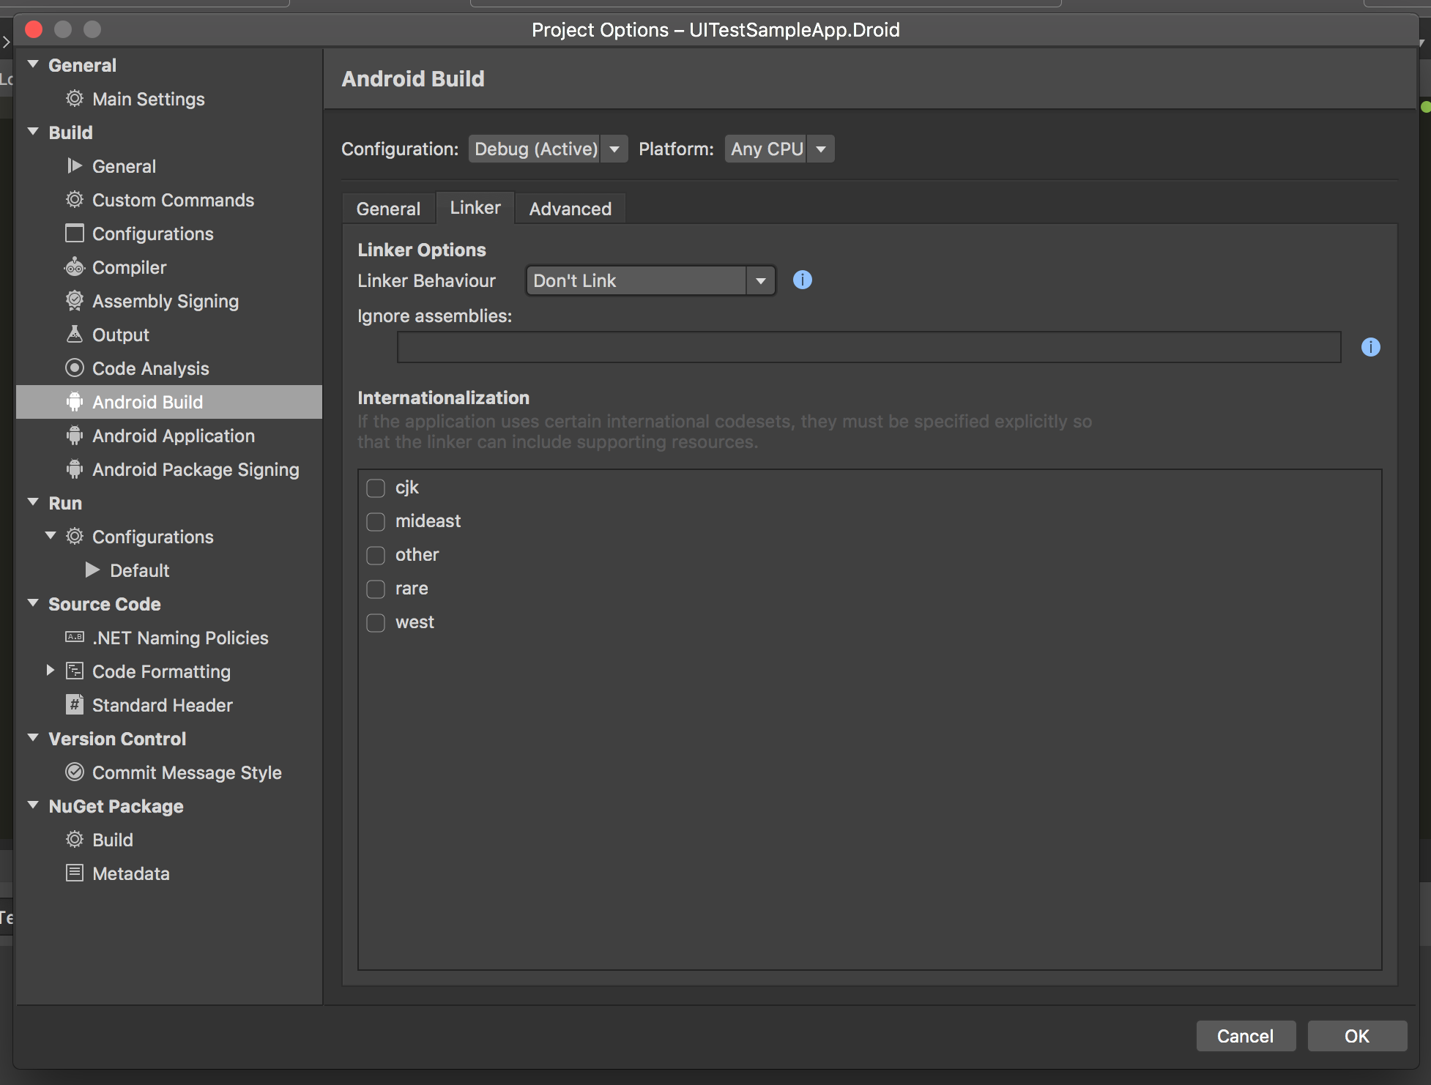
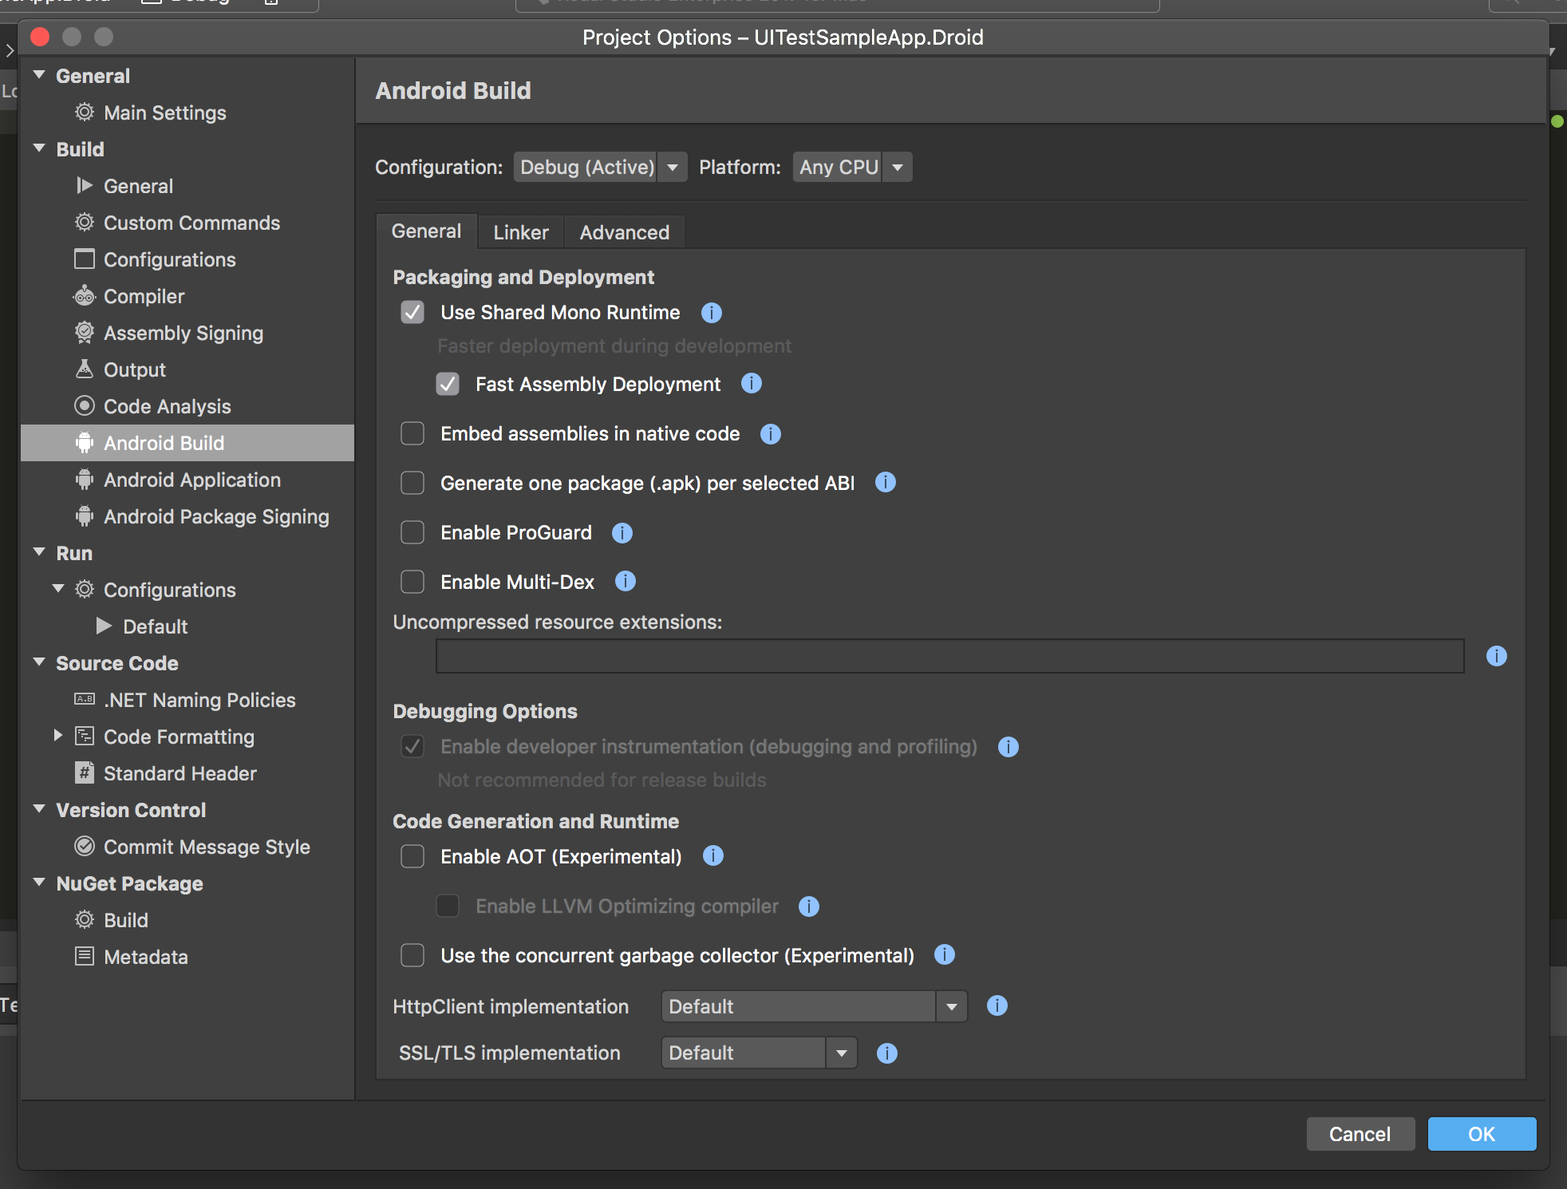
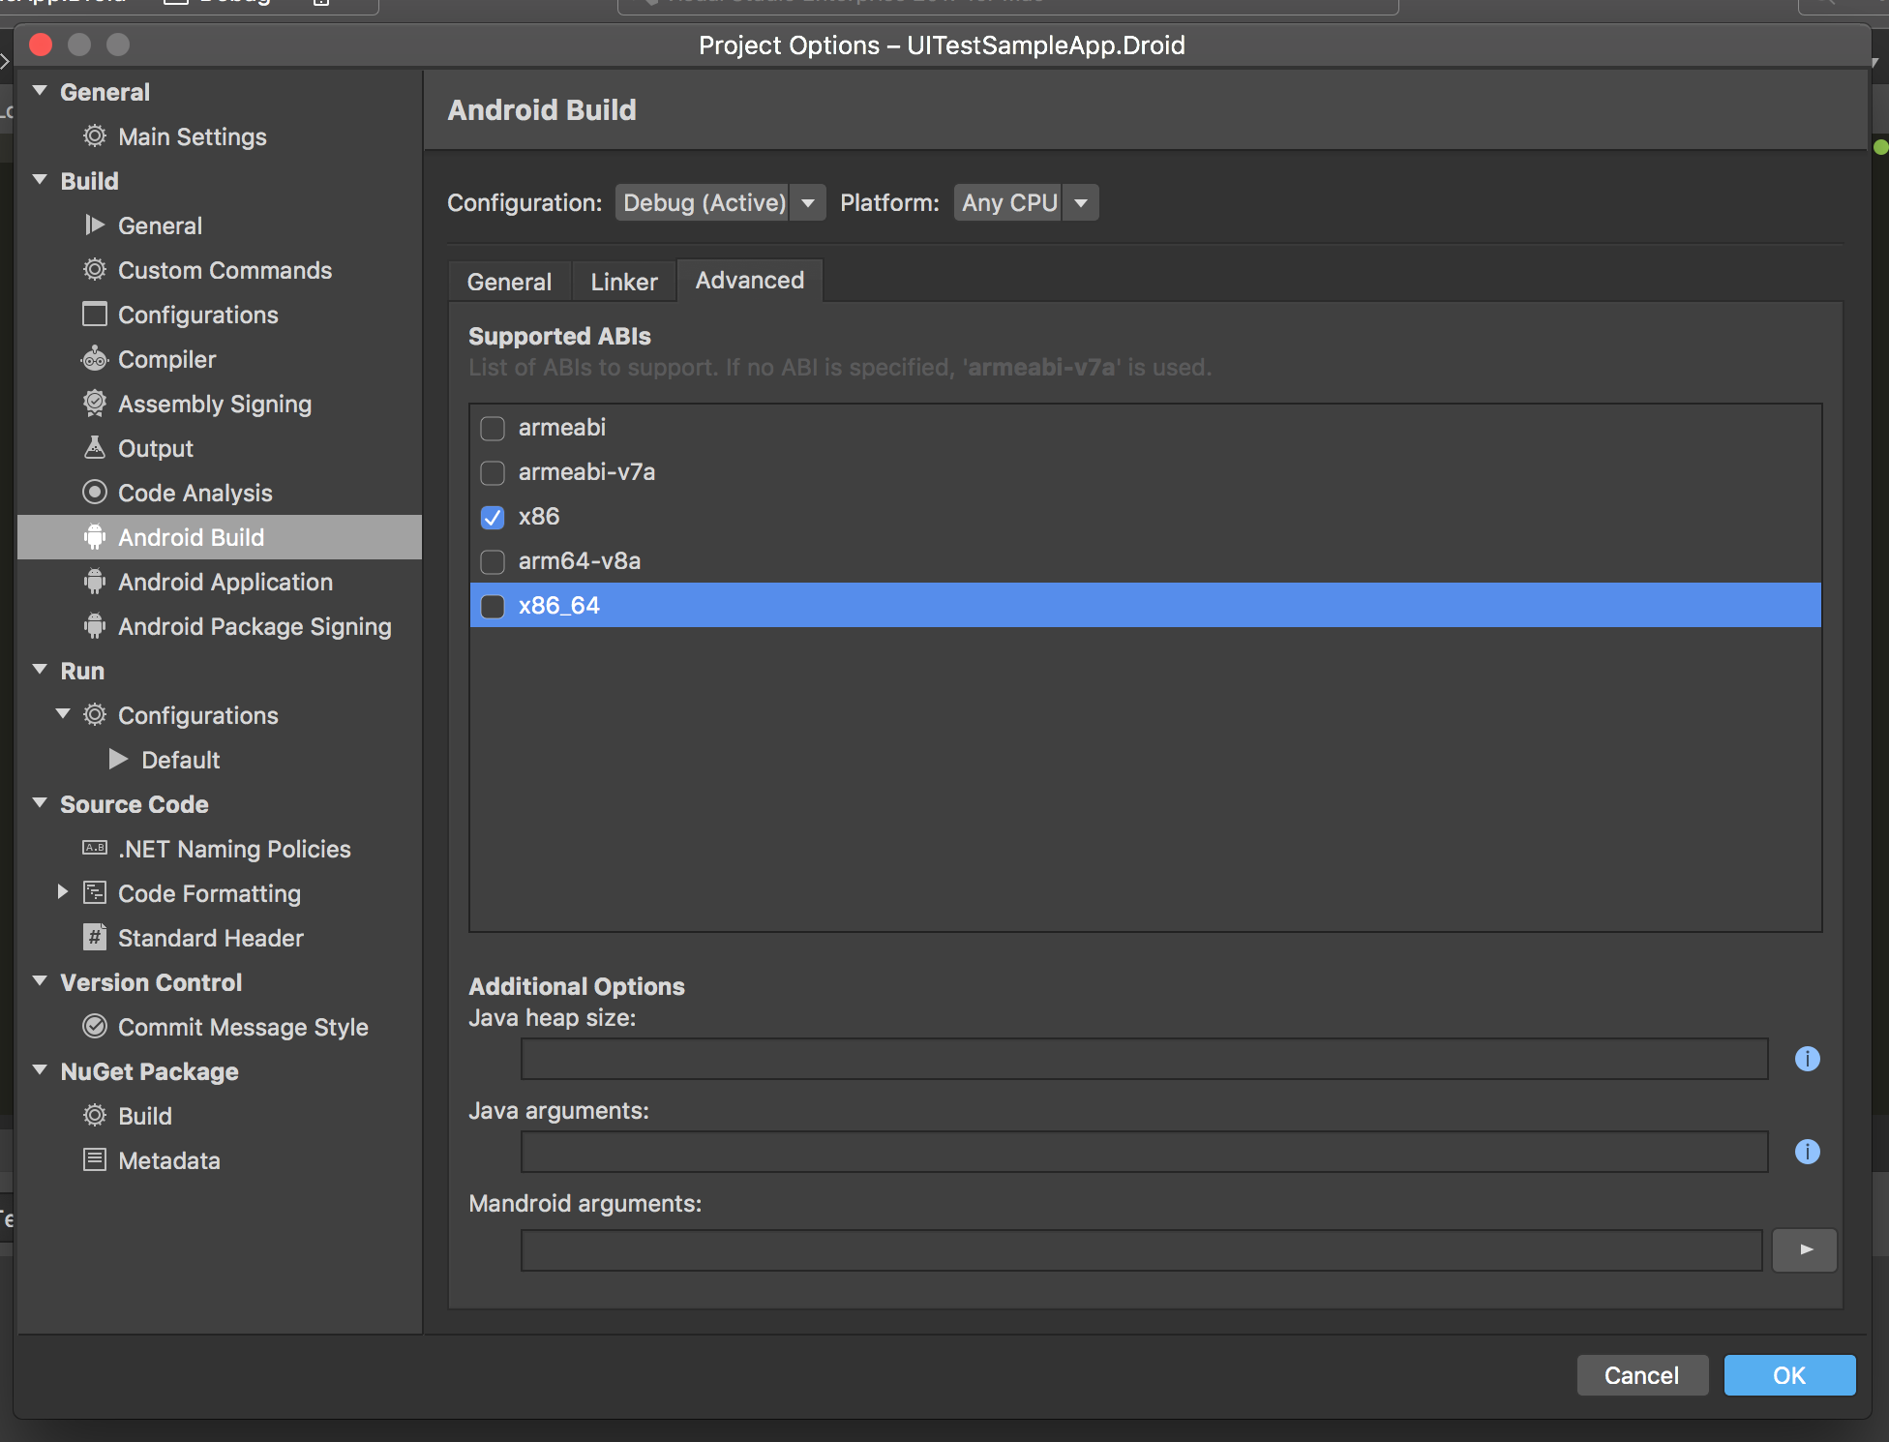
Android Build Settings
General
Use Shared Mono Runtime
This will install mono on the targeted device and allows the compiler to only compile the managed code
Fast Assembly Deployment
Doesn’t compile assemblies and deploys assemblies directly to the device
Linker
Linker Behavior: Don’t Link
Linking will cause compilation to take longer
Advanced
Supported ABIs
Select the ABI for the targeted device
E.g. if you’re deploying to an x86 emulator, only select the x86 ABI

Slide 3
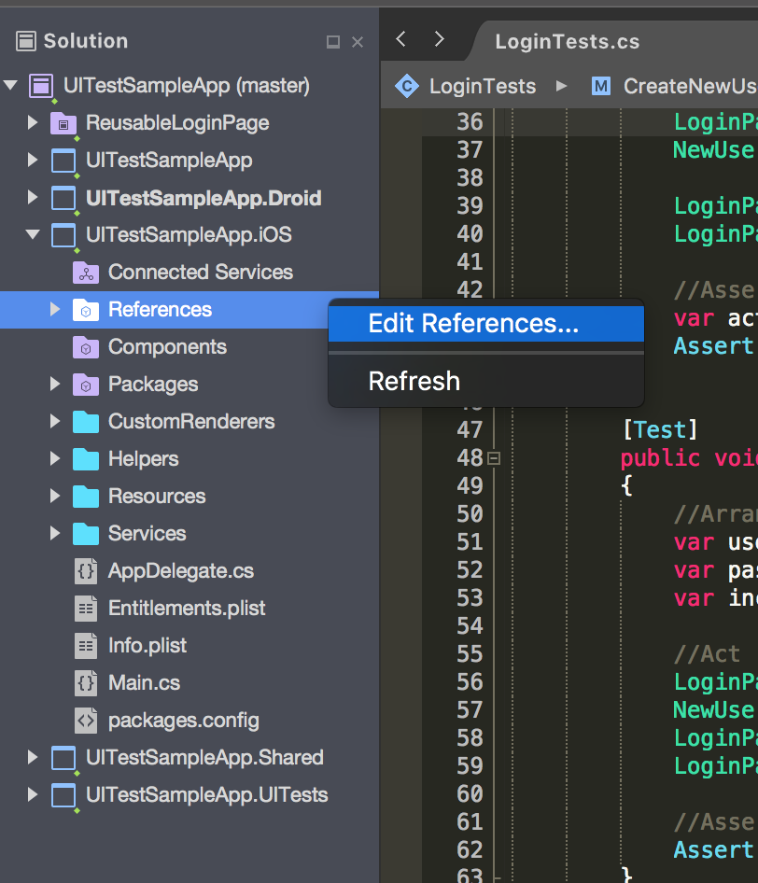
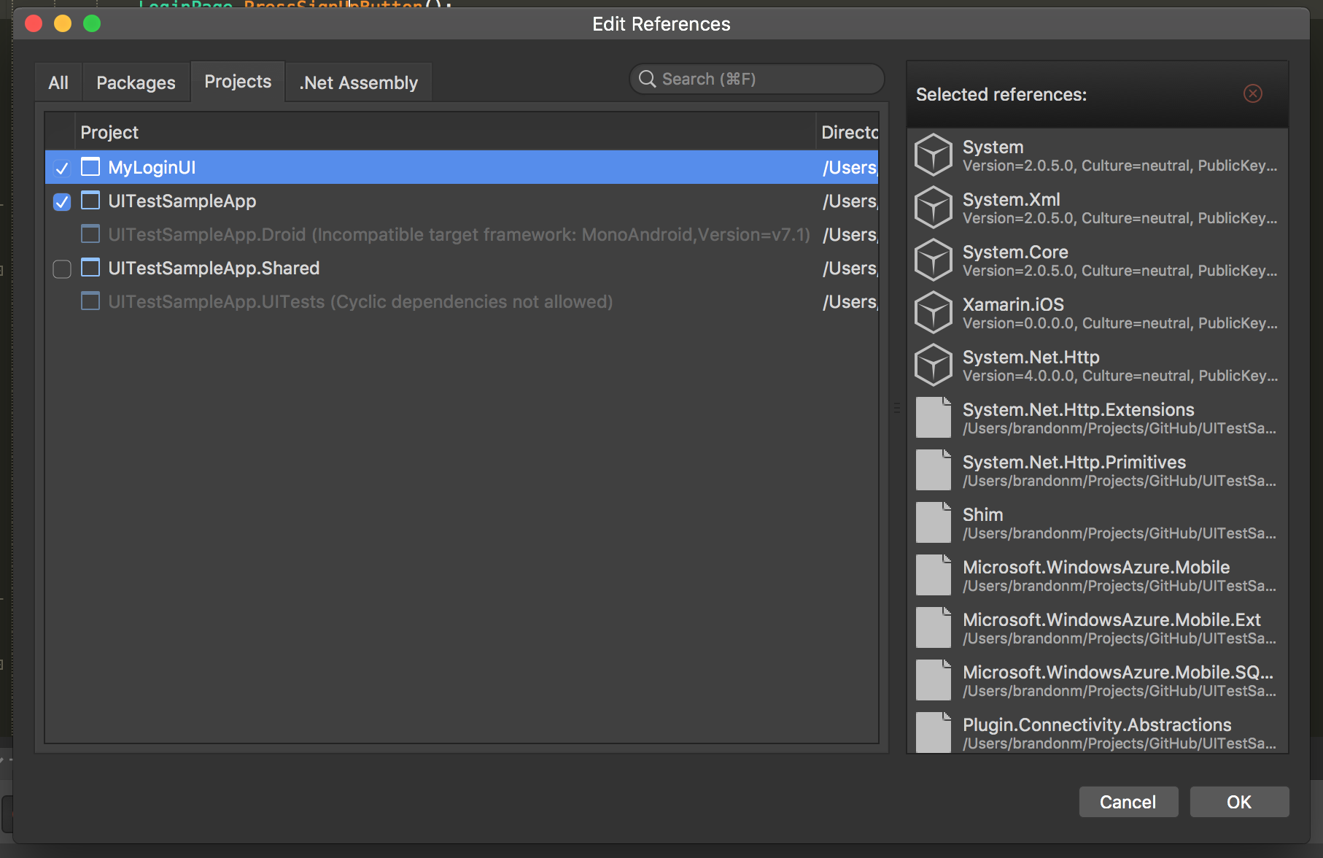
Project References
Limit the number of referenced projects in the solution
Compilation time increases for every referenced PCL
Referenced PCLs will compile first, then the Startup Project will compile
Shared Projects will compile faster than PCLs

